Slide 1
DIABETIC RETINOPATHY PREDICTION IN PATIENTS
Presented by:
Ankur Choudhury

Slide 2
Business Problem:
To predict whether a patient will suffer from diabetic retinopathy or not.
Objective:
The objective of the analysis is to predict whether a patient will suffer from diabetic
retinopathy or not on the basis of blood test features.

Slide 3
Project Architecture
Problem identification
Decide on a problem
Data identification
Acquire data
Clean data
Extract features
Pre-processing
Deal with missing data
Data Scaling
Generate models
Model processing
Select final model
Evaluate final model
Application
Use model

Slide 4
Dataset Details
Dataset used: pronostico_dataset (1).csv
Data details:
Therefore, from the above it can be interpreted that there are 6000 rows & 6 columns in the given pronostico_dataset.
Number of rows | 6000
Number of columns | 6
Data types | int64 = 1 float64 = 4 Object =1
Duplicates | 0

Slide 5
Exploratory Data Analysis
(EDA)

Slide 6
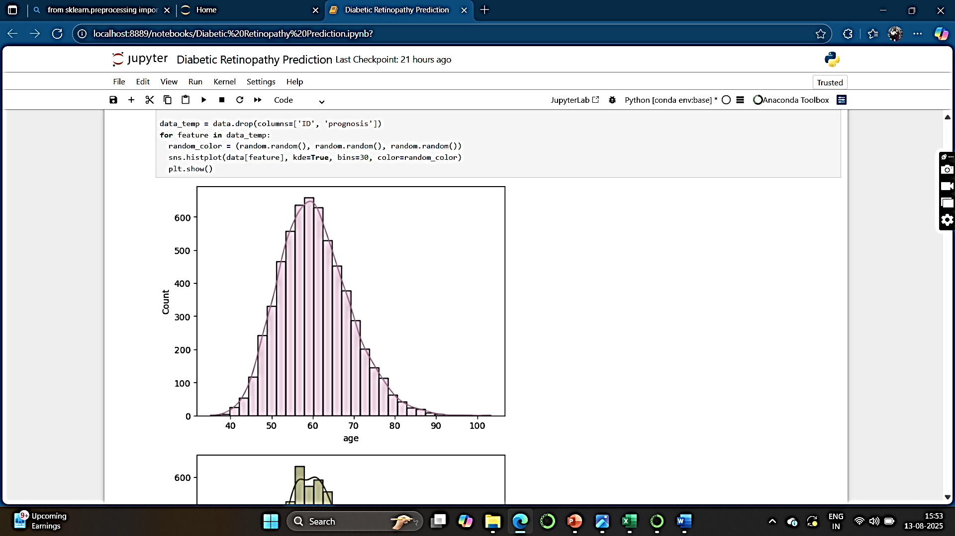
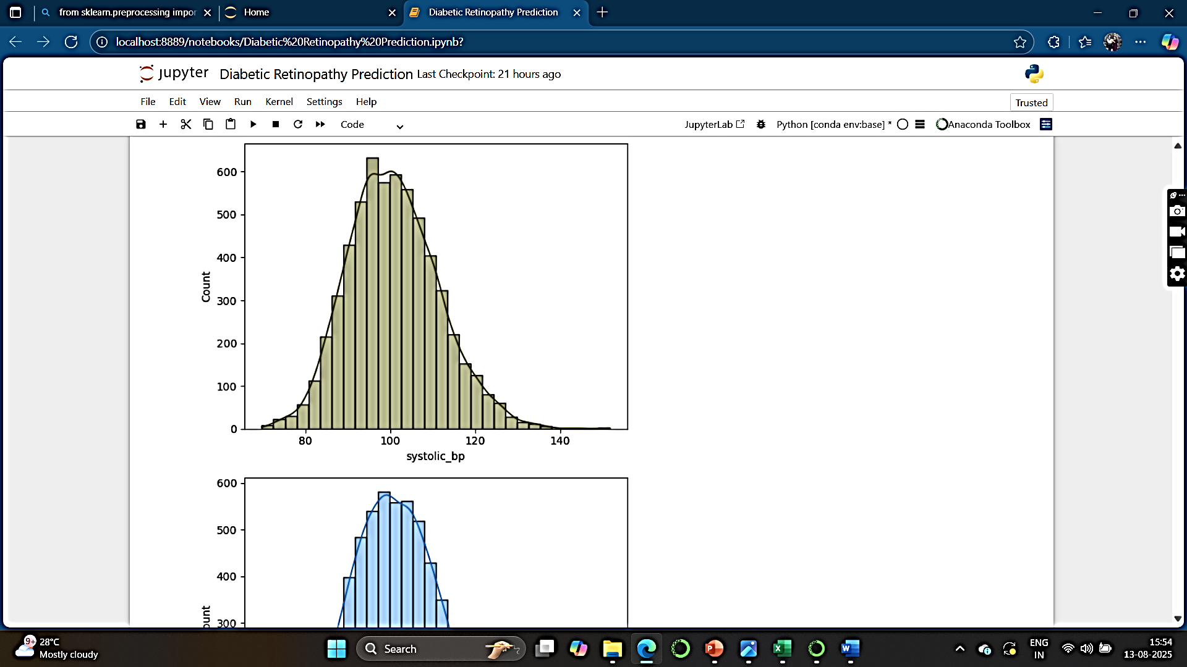
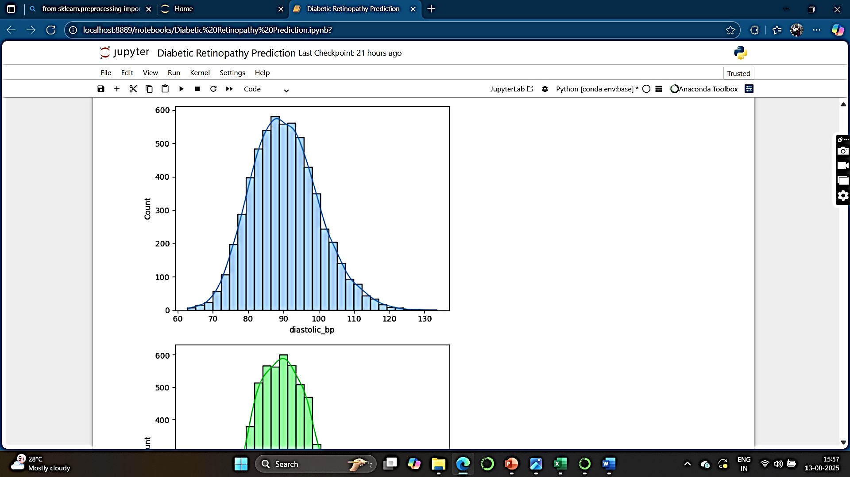
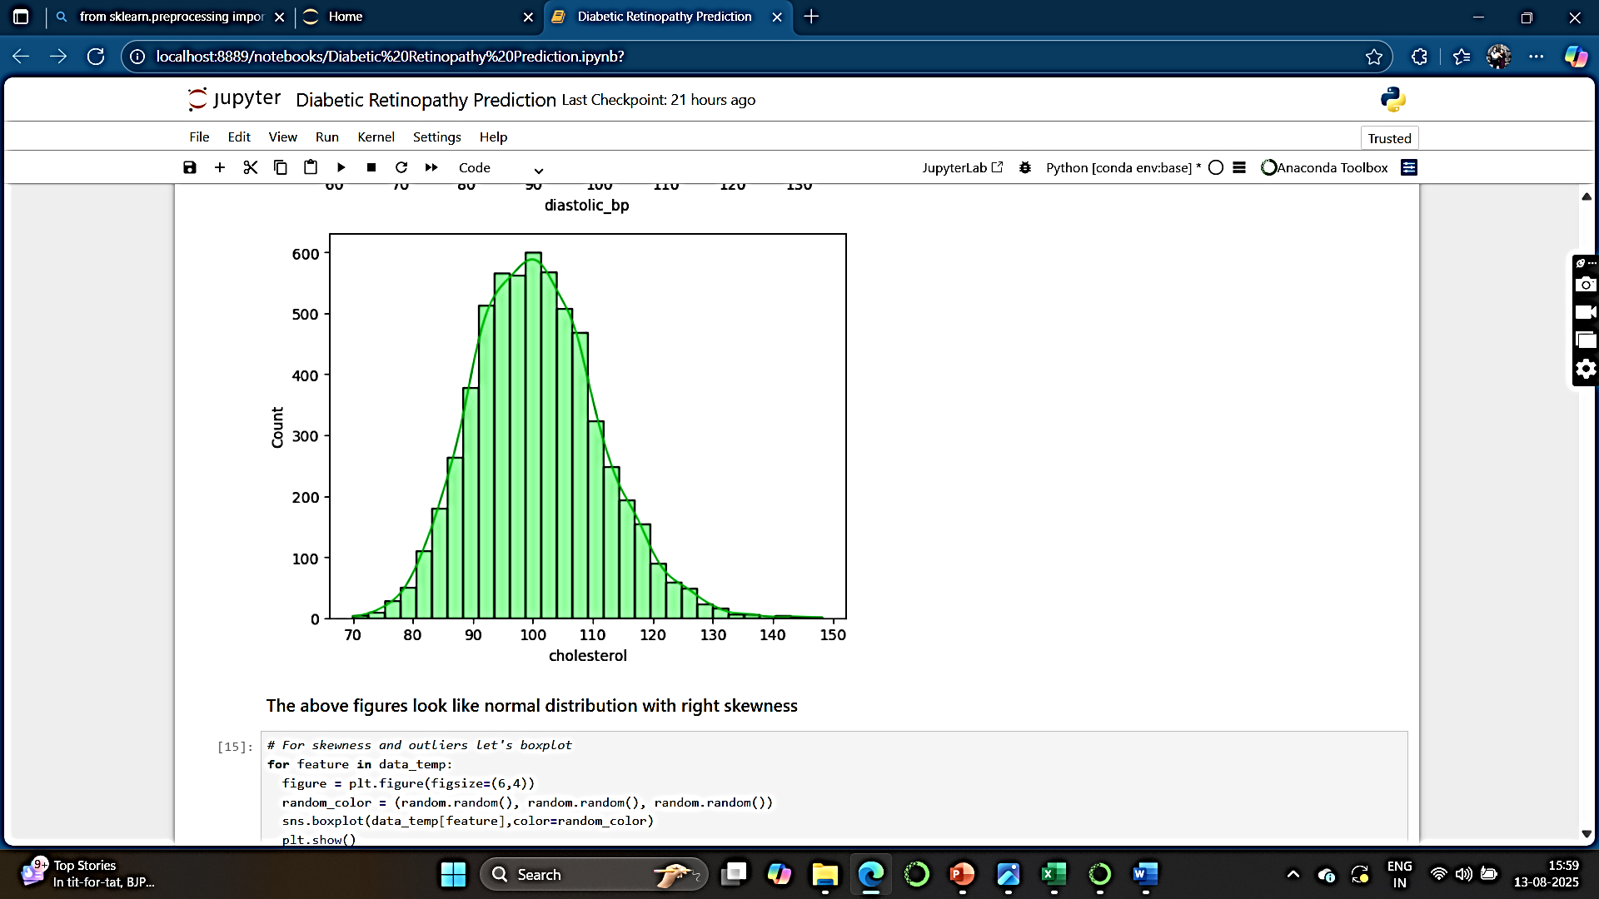
Data Visualization
Histogram Plot :
Removing ID and prognosis columns temporarily-
import randomdata_temp = data.drop(columns=['ID', 'prognosis’])
for feature in data_temp: random_color = (random.random(), random.random(), random.random())
sns.histplot(data[feature], kde=True, bins=30, color=random_color)
plt.show()

Slide 7
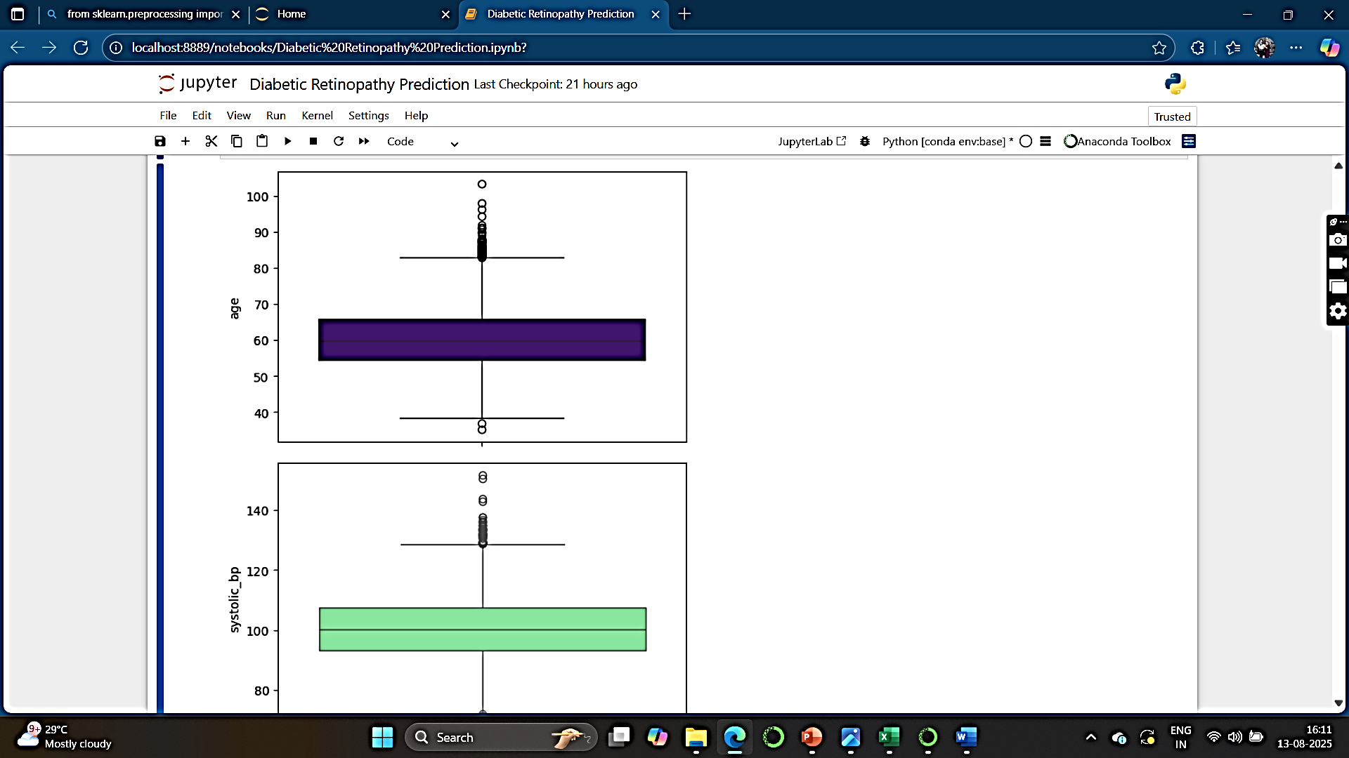
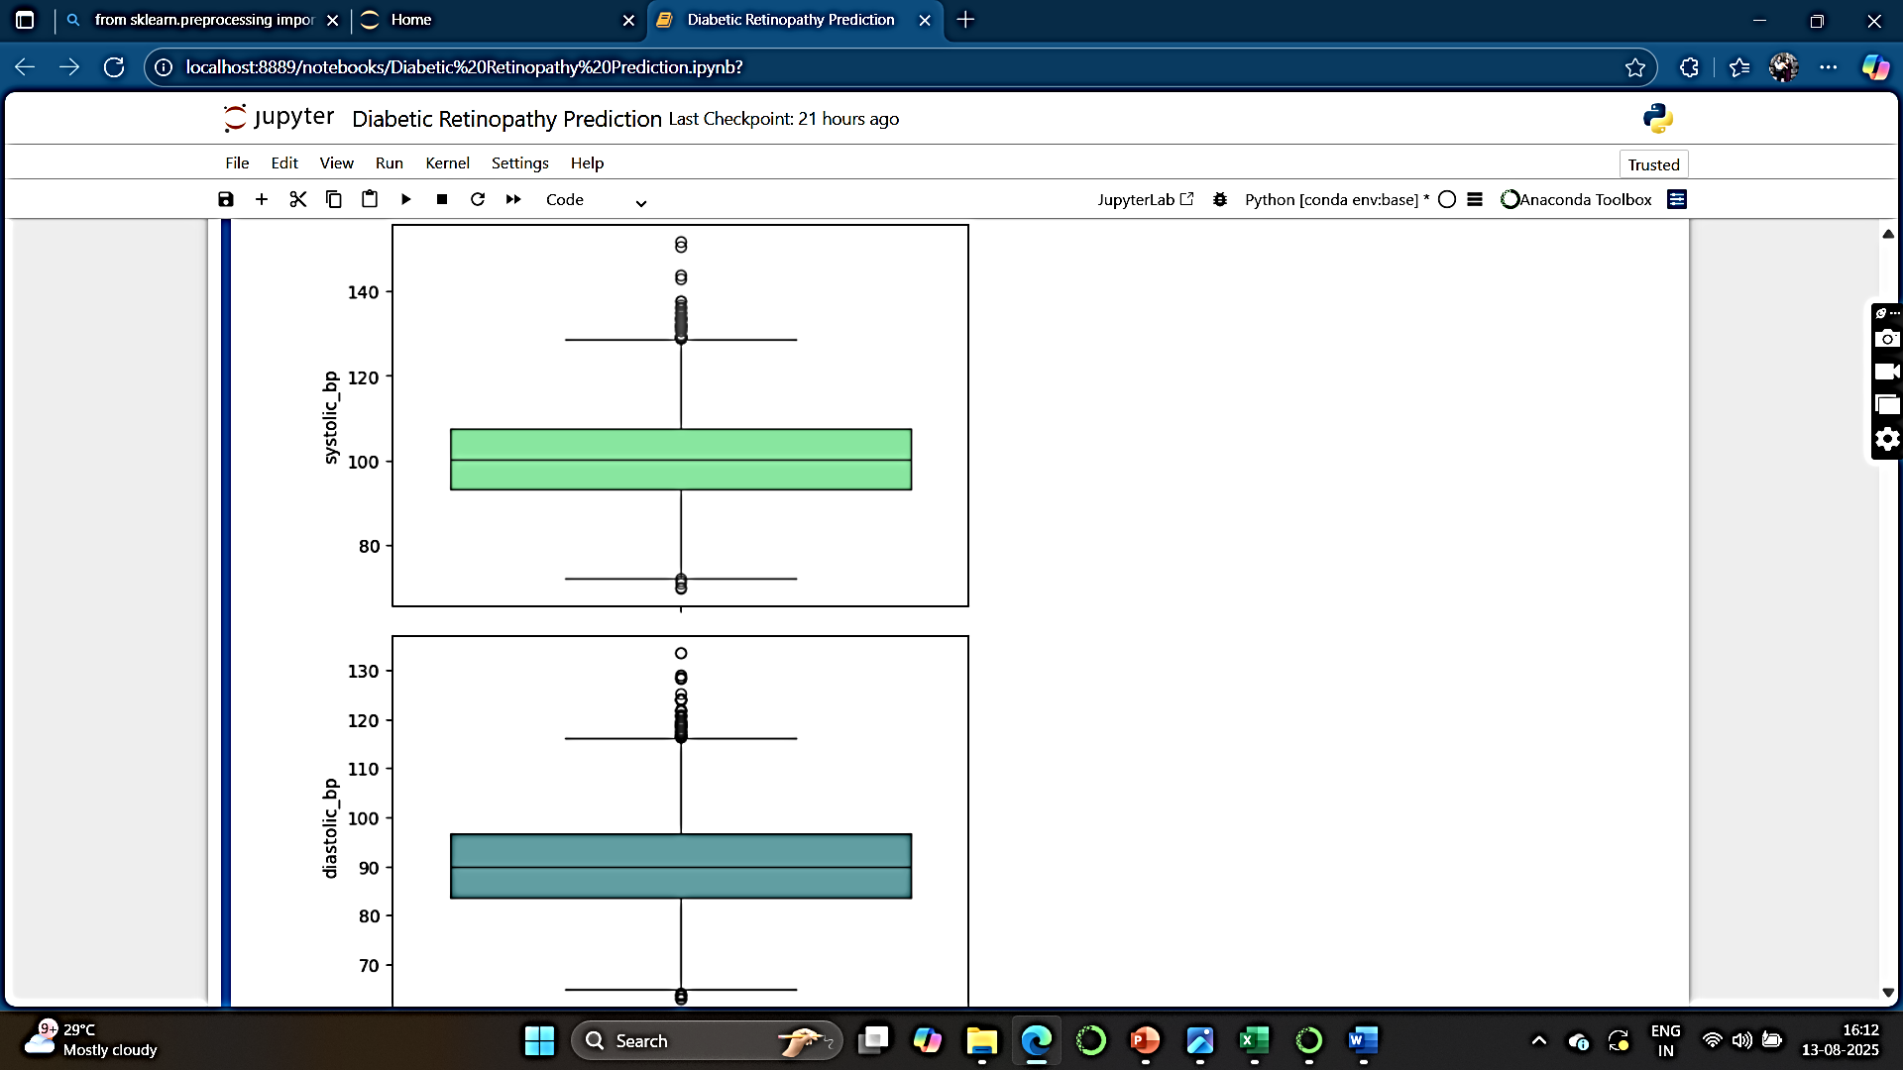
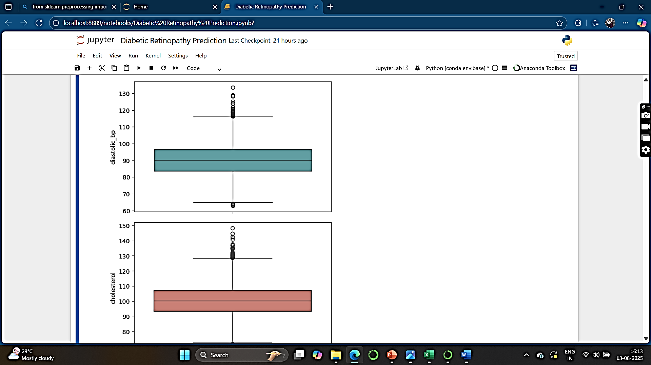
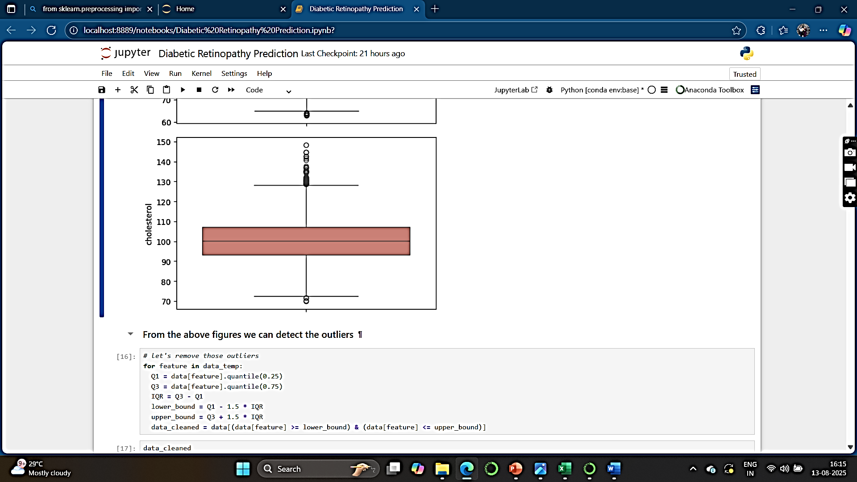
Box plot :
for feature in data_temp: figure = plt.figure(figsize=(6,4))
random_color = (random.random(), random.random(), random.random()) sns.boxplot(data_temp[feature],color=random_color)
plt.show()
From the boxplot, we can detect the outliers.

Slide 8
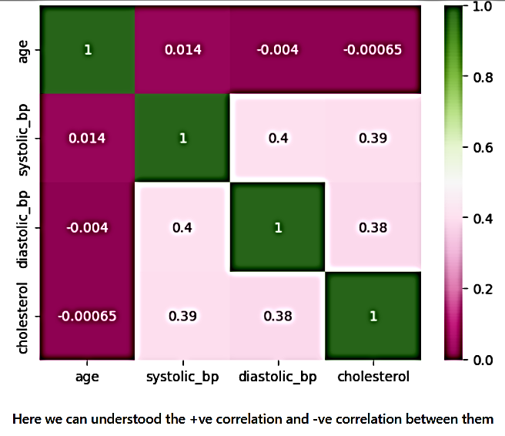
Heat Map:
sns.heatmap(data_temp2.corr(), annot=True, cmap="PiYG")
plt.show()
From the heatmap, we can visualize the correlation.

Slide 9
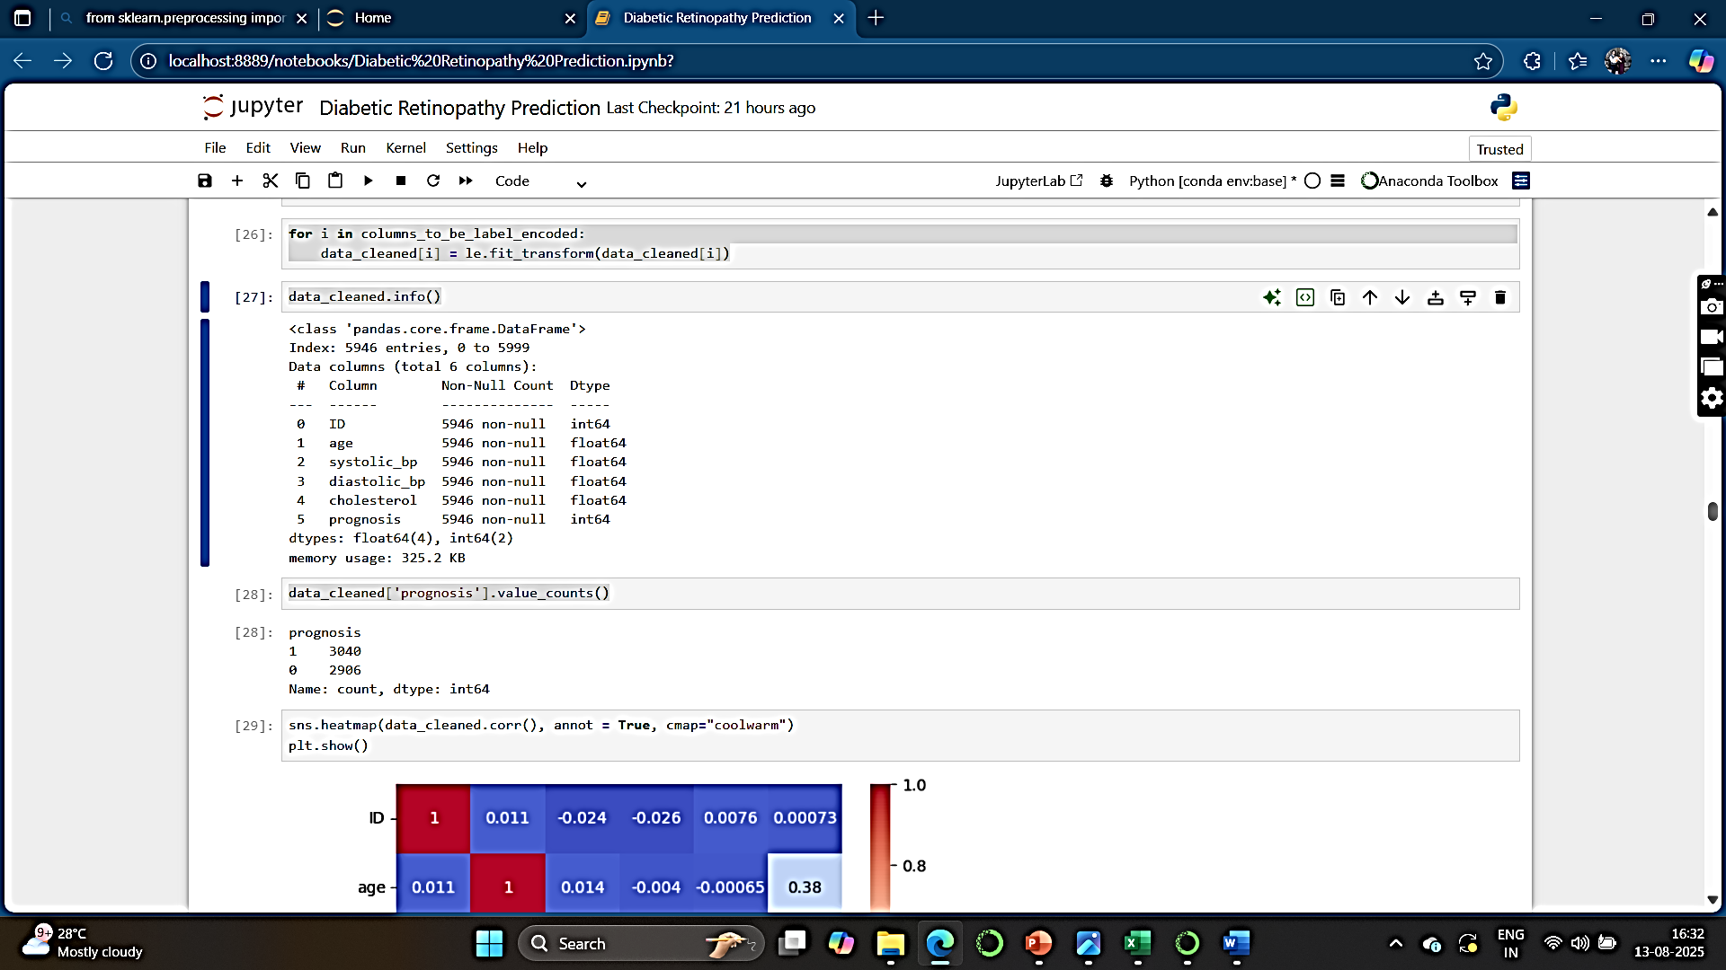
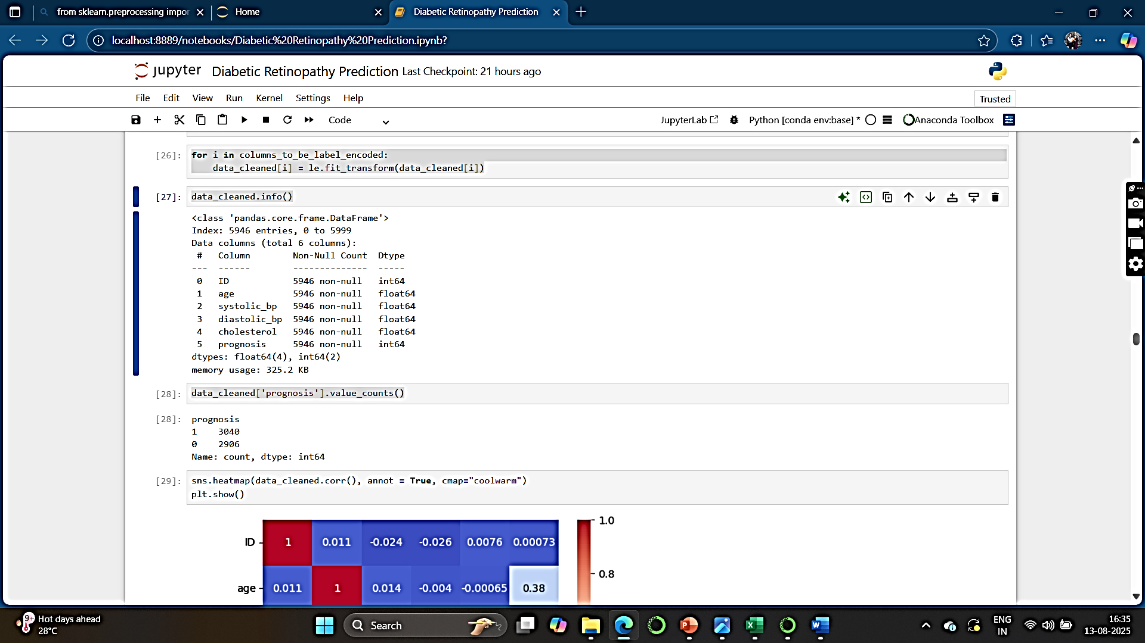
Label Encoder:
In classification algorithms the outputs are 0 and 1 as we know.
The prognosis column has to be encoded to make the true value 1 as ‘Retinopathy’ and false value 0 as ‘No_Retinopathy’.
le = LabelEncoder()
le
columns_to_be_label_encoded =['prognosis’]
for i in columns_to_be_label_encoded:
data_cleaned[i] = le.fit_transform(data_cleaned[i])
data_cleaned.info() data_cleaned['prognosis'].value_counts()

Slide 10
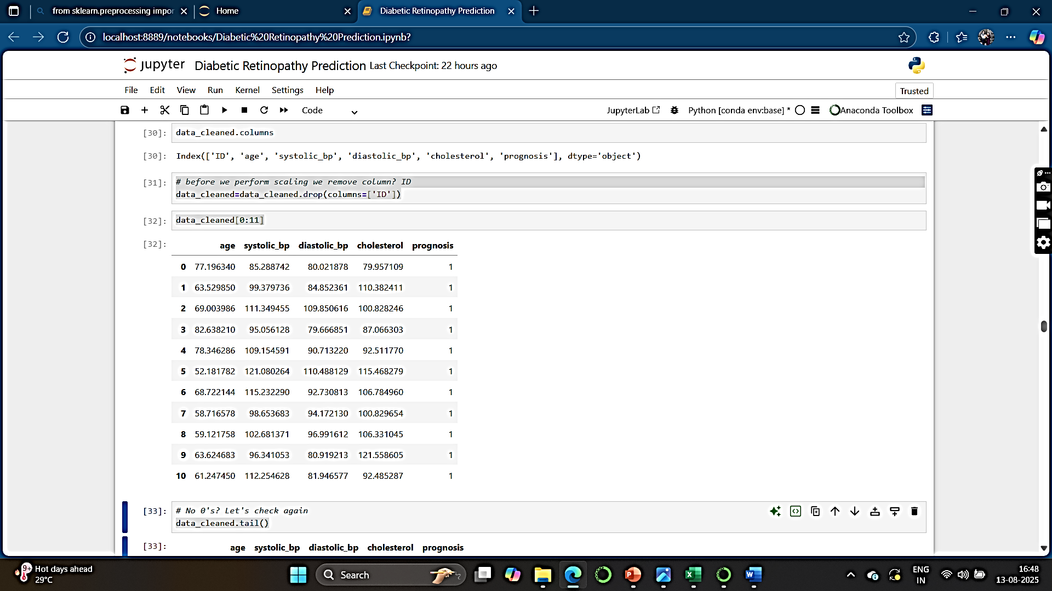
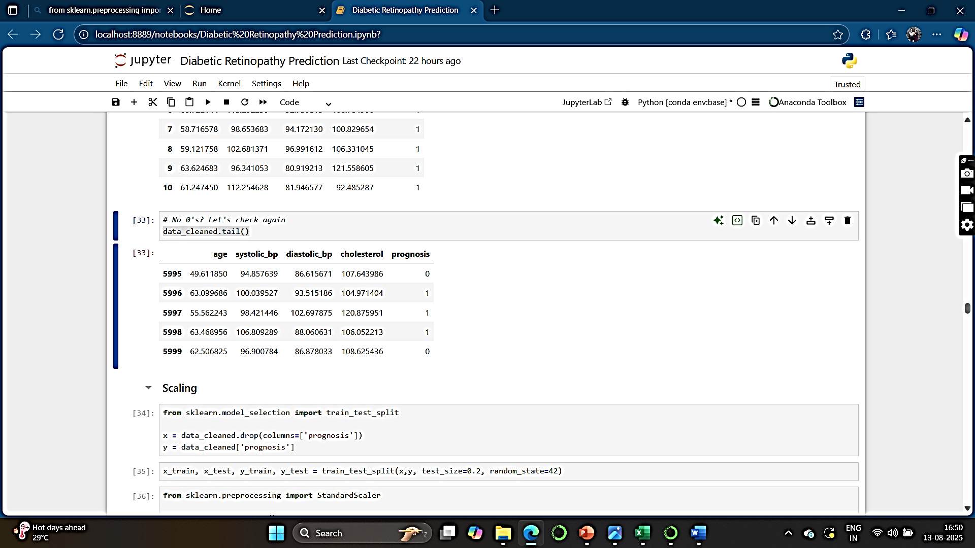
Before we perform scaling we remove column ID :
data_cleaned=data_cleaned.drop(columns=['ID’])
data_cleaned[0:11] data_cleaned.tail()
Here, we can see that 0’s are present in the prognosis column.

Slide 11
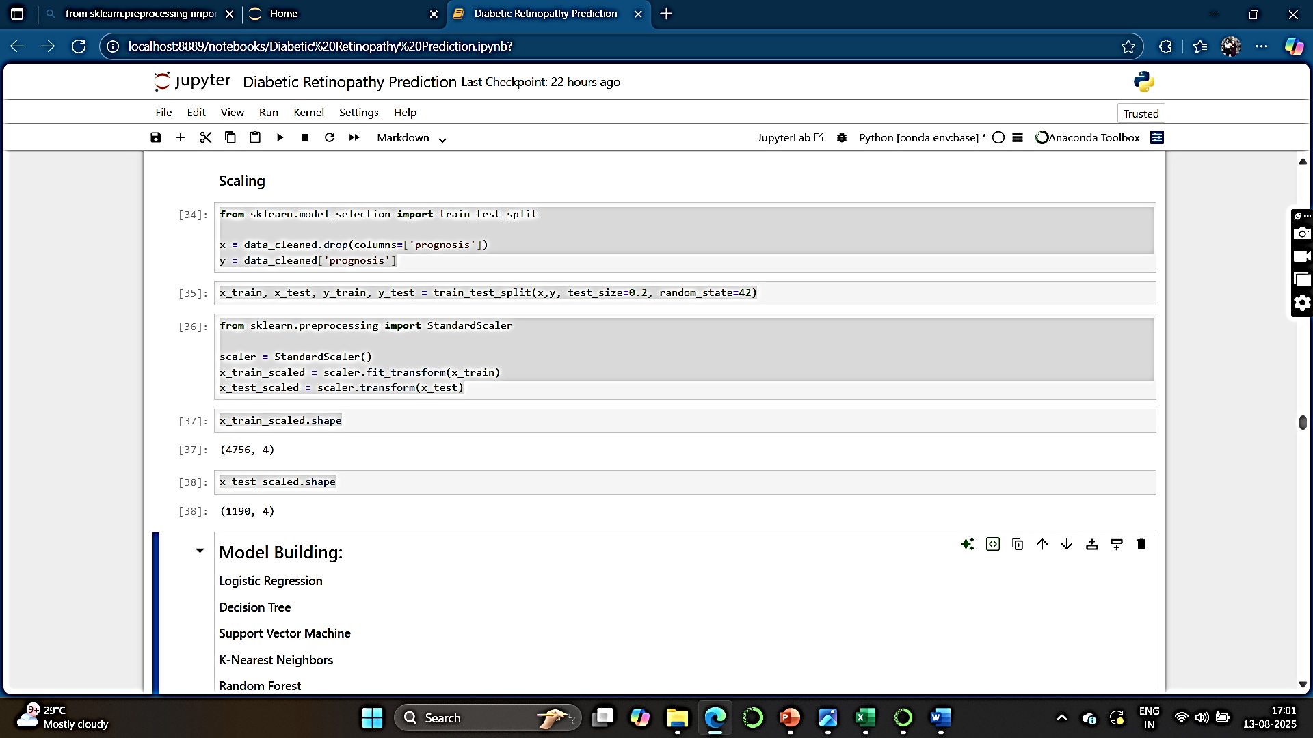

Data Scaling:
from sklearn.model_selection import train_test_split
x = data_cleaned.drop(columns=['prognosis’])
y = data_cleaned['prognosis’]
x_train, x_test, y_train, y_test = train_test_split(x,y, test_size=0.2, random_state=42)
from sklearn.preprocessing import StandardScalerscaler = StandardScaler()
x_train_scaled = scaler.fit_transform(x_train)
x_test_scaled = scaler.transform(x_test)
x_train_scaled.shape x_test_scaled.shape

Slide 12
MODEL BUILDING

Slide 13
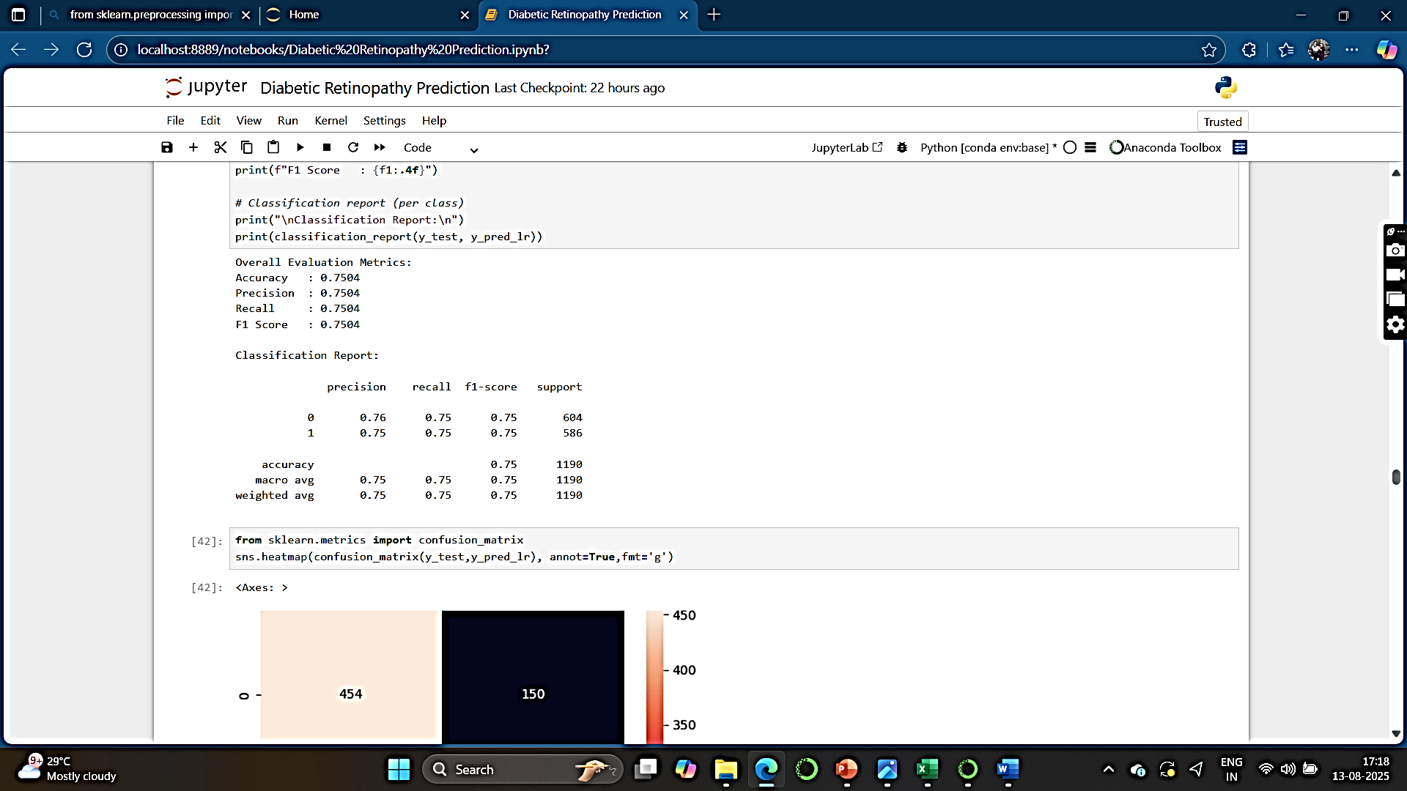
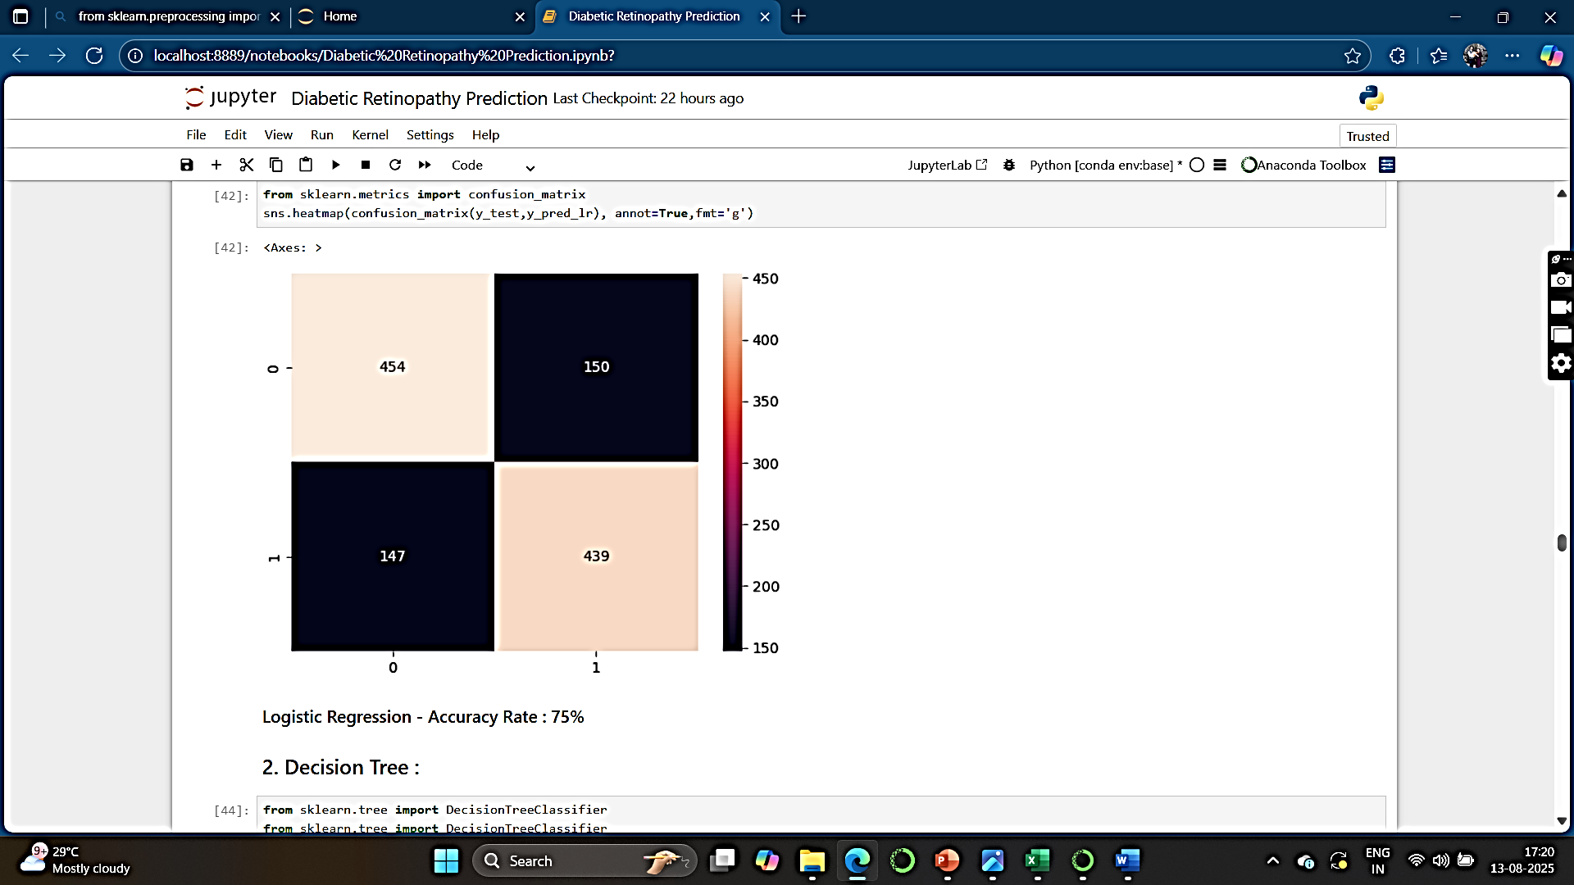
Logistic Regression :
Key Points :– Heat Map of Confusion Matrix:

Slide 14
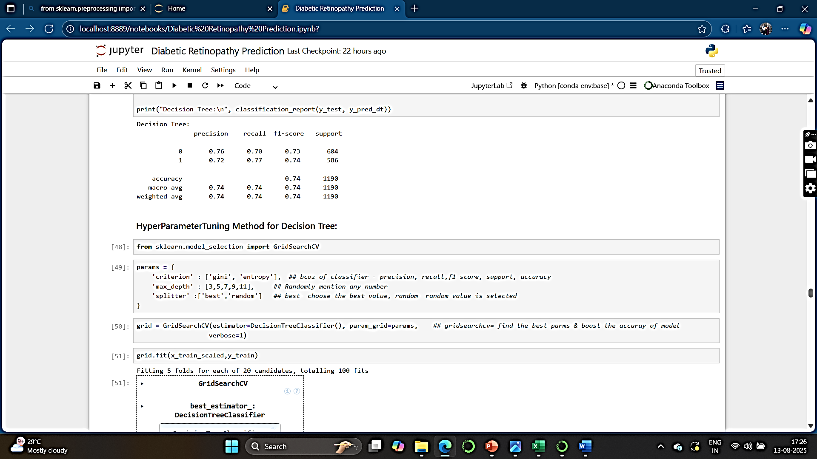

2. Decision Tree :
Key Points :– Heat Map of Confusion Matrix :

Slide 15
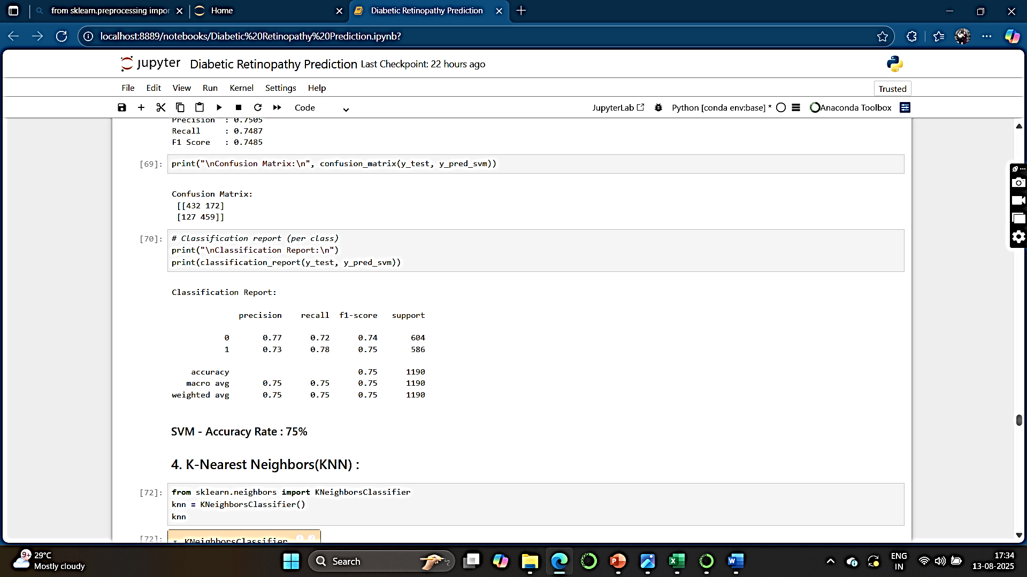
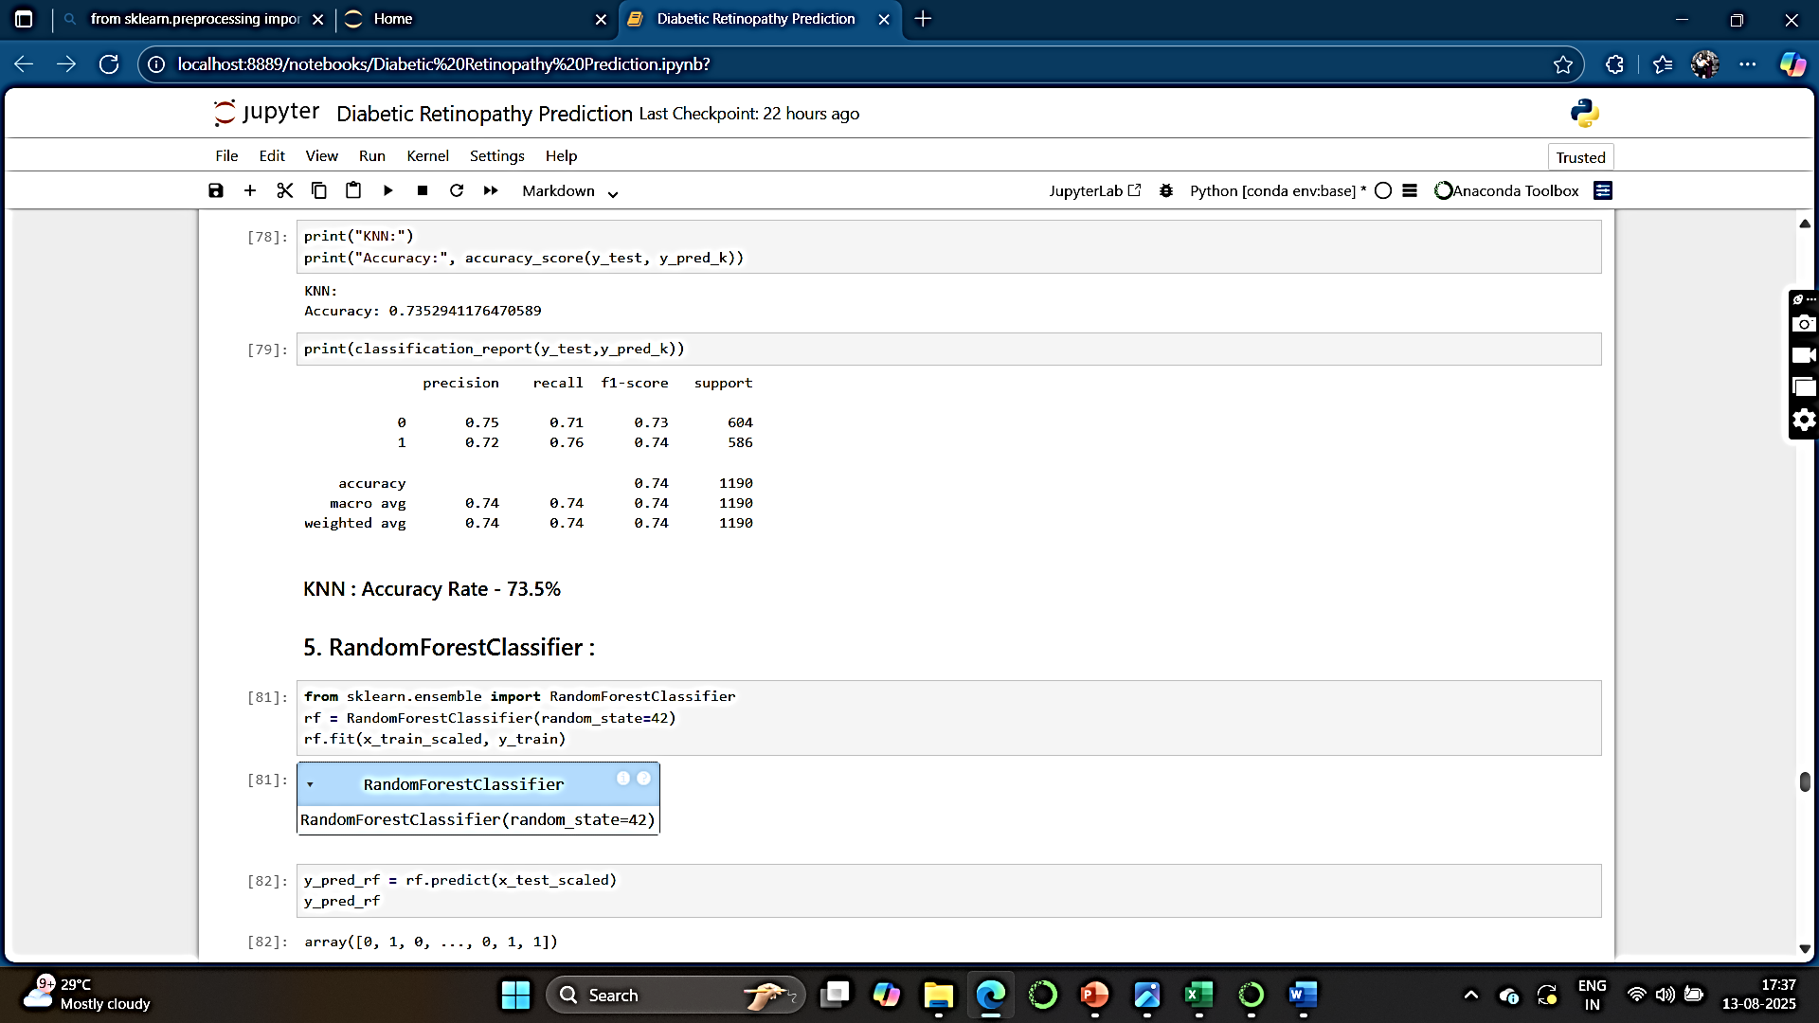
3. Support Vector Machine : 4. K-Nearest Neighbors (KNN) :
Key Points :– Key Points :–

Slide 16
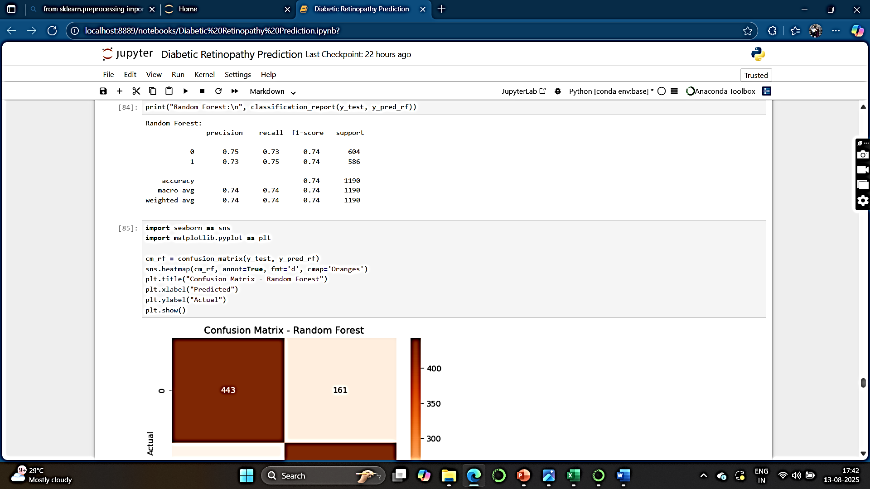
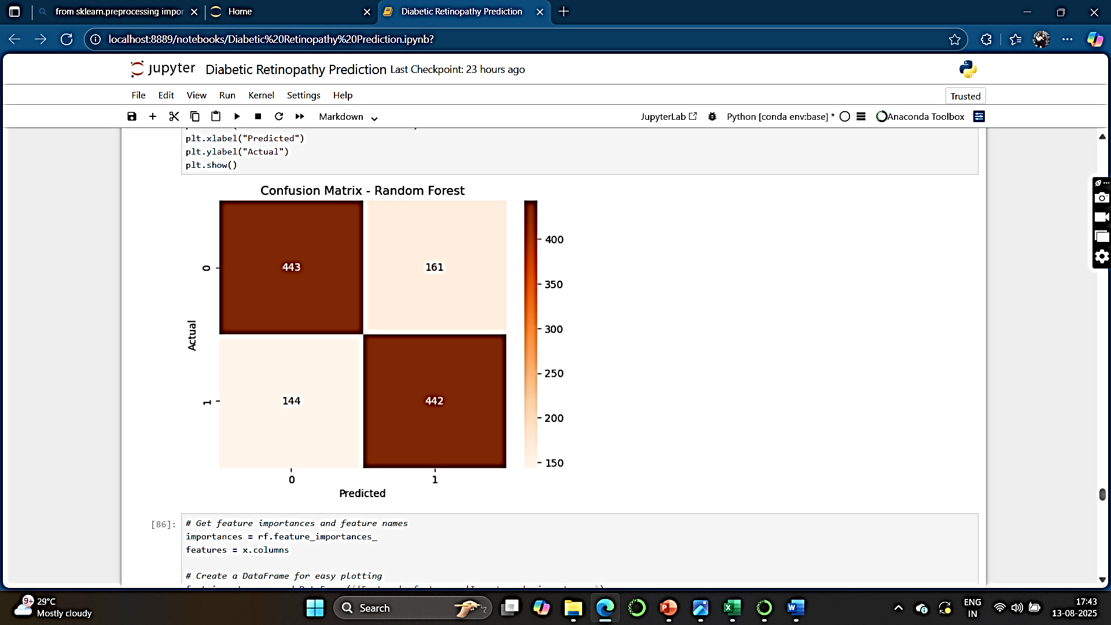
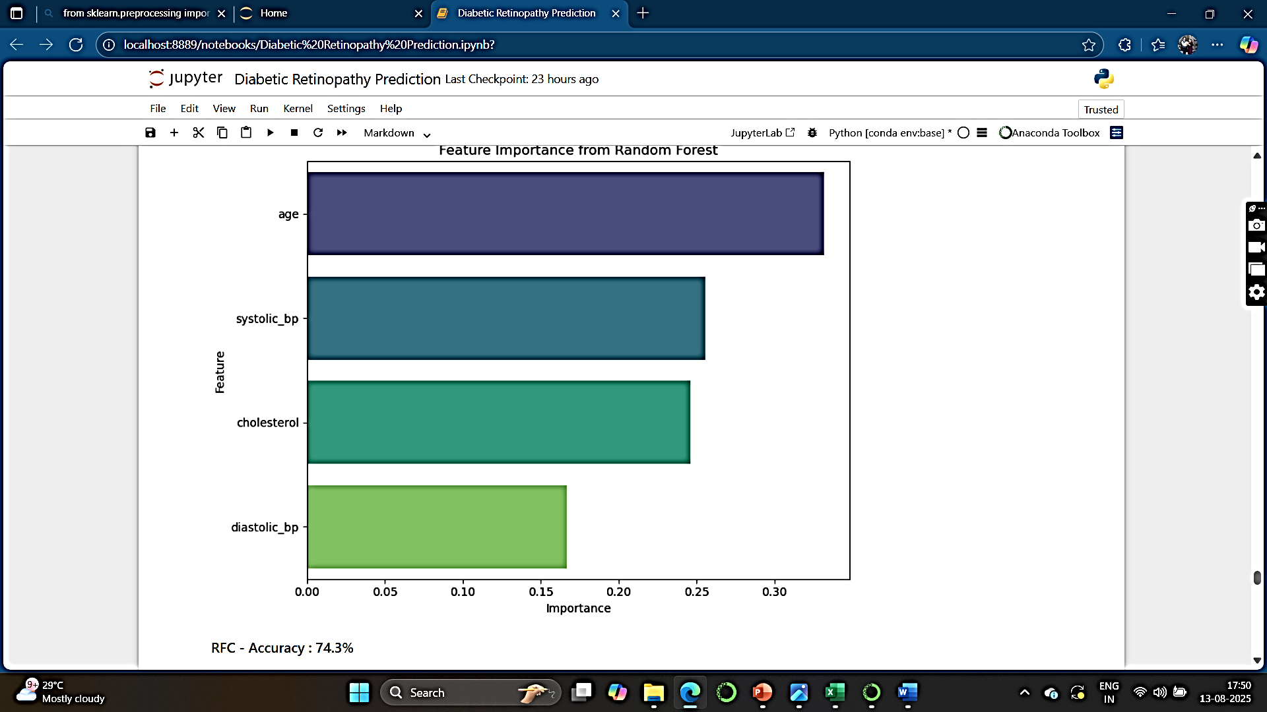
5. Random Forest Classifier :
Key Points :– Heat Map of Confusion Matrix :

Slide 17
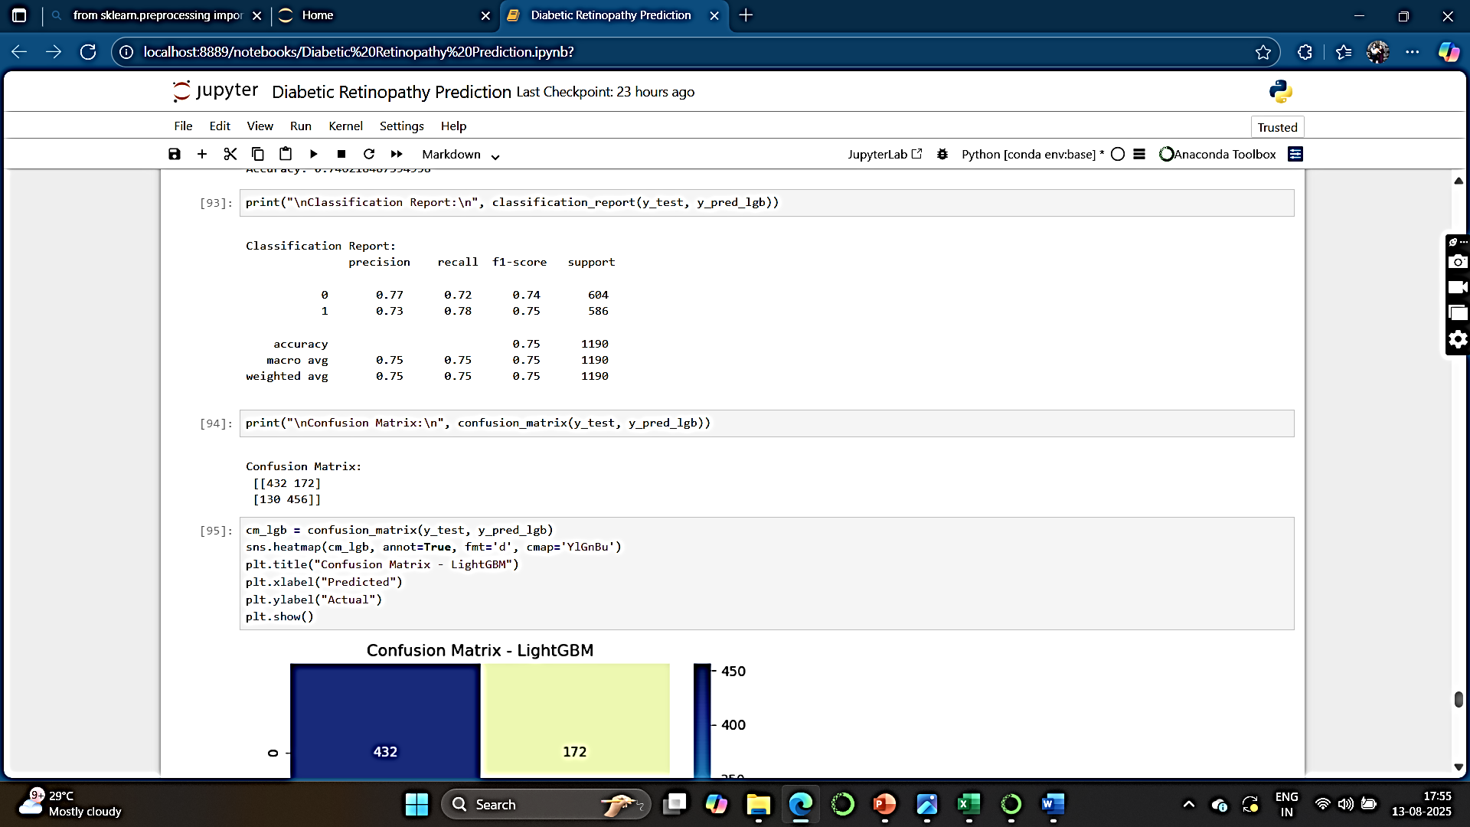
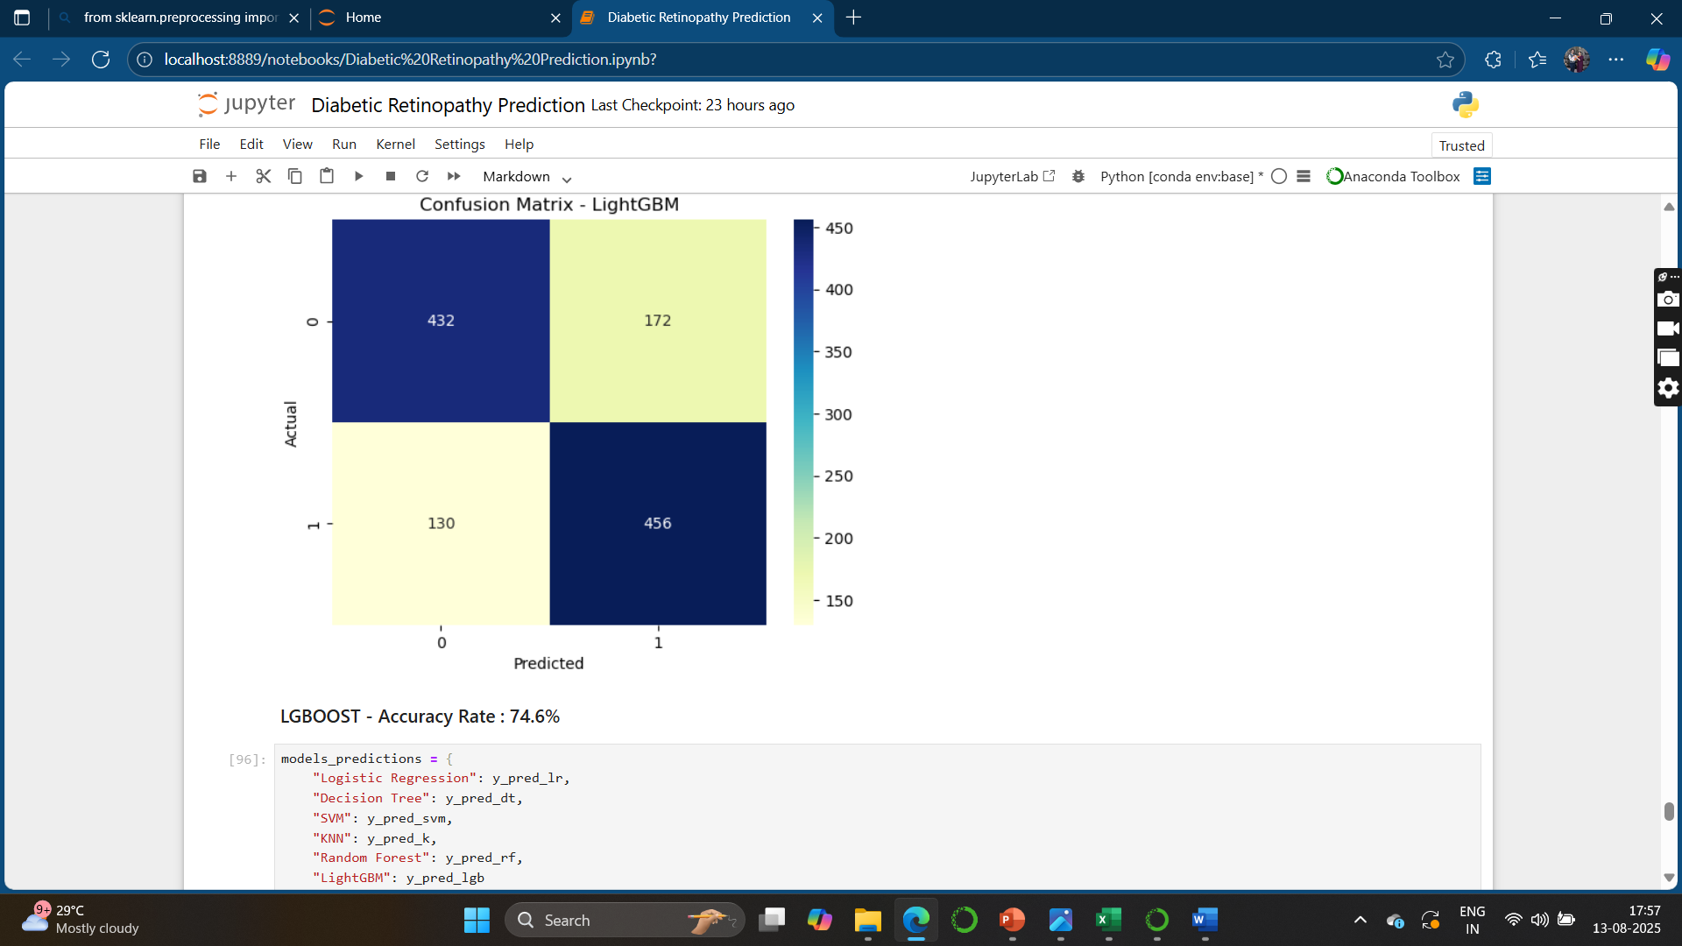

6. LightGBM (LGBM) Classifier :
Key Points :– Heat Map of Confusion Matrix :

Slide 18
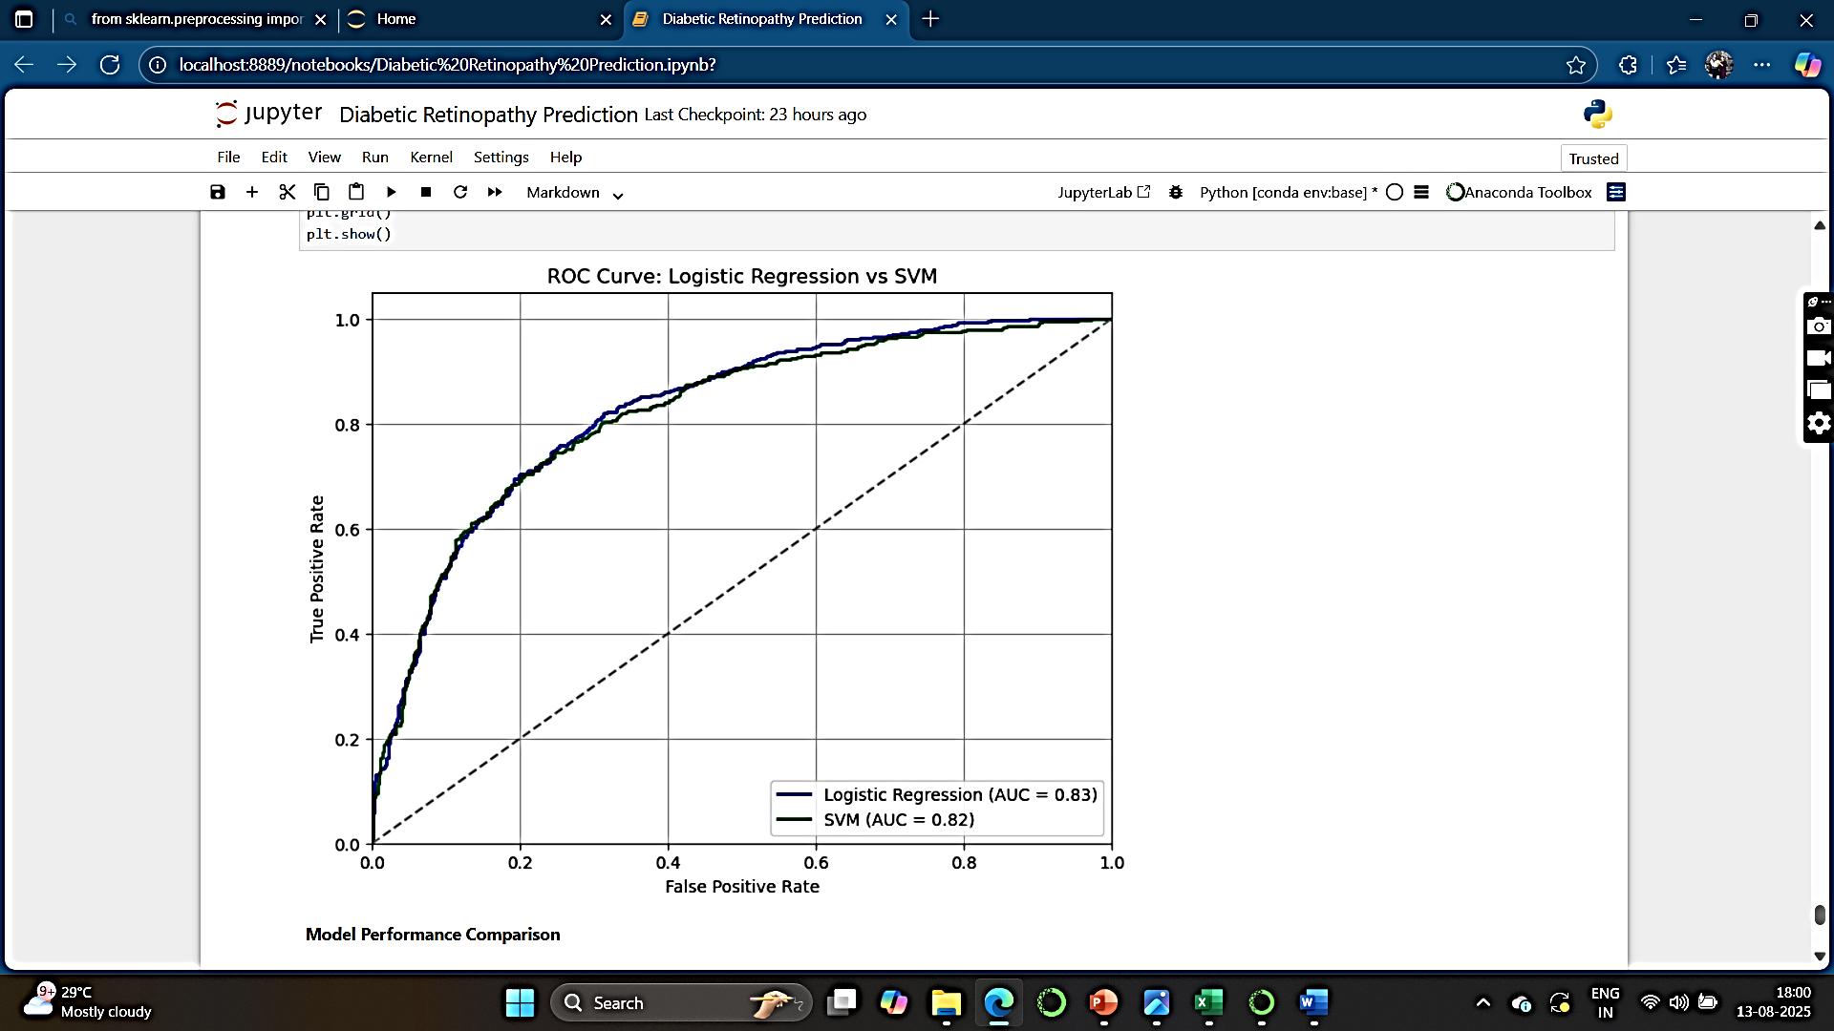
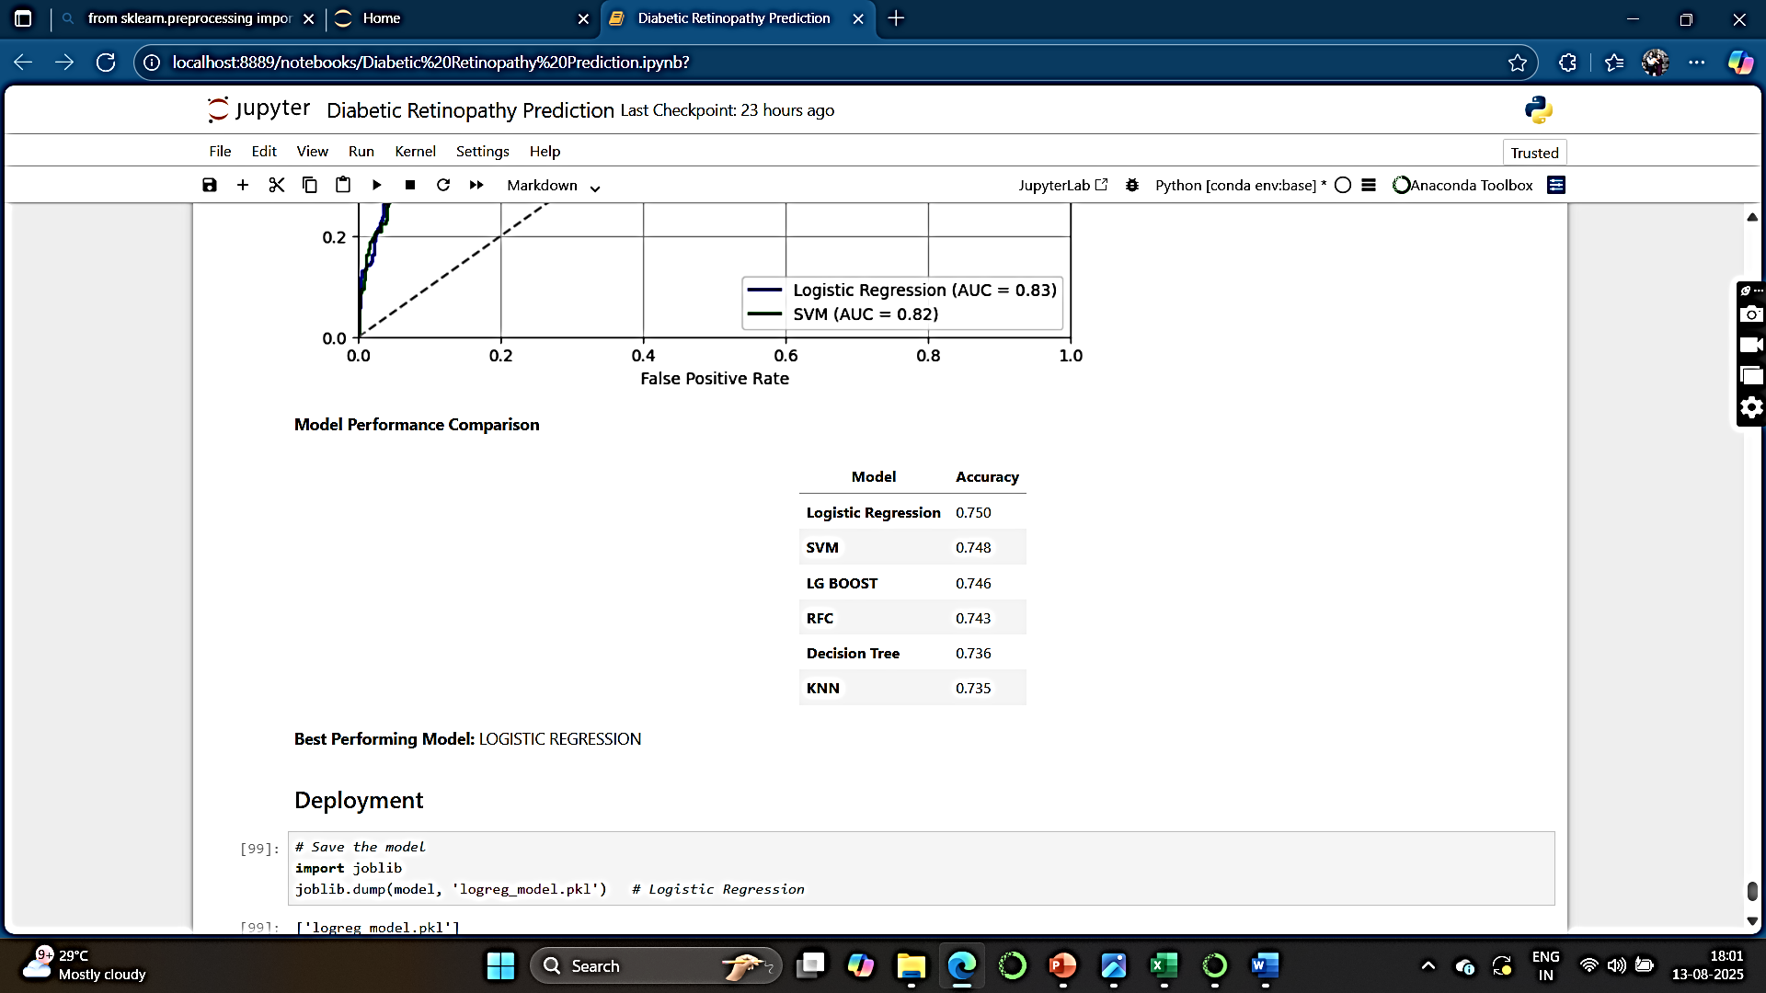

Slide 19
DEPLOYMENT

Slide 20
According to the training and testing accuracy, we consider logistic regression for deployment.
Deployment of the model is done using Streamlit.
Streamlit offers rapid development, ease of use, and seamless integration with Python libraries, making it an ideal choice for building interactive data applications.

Slide 21
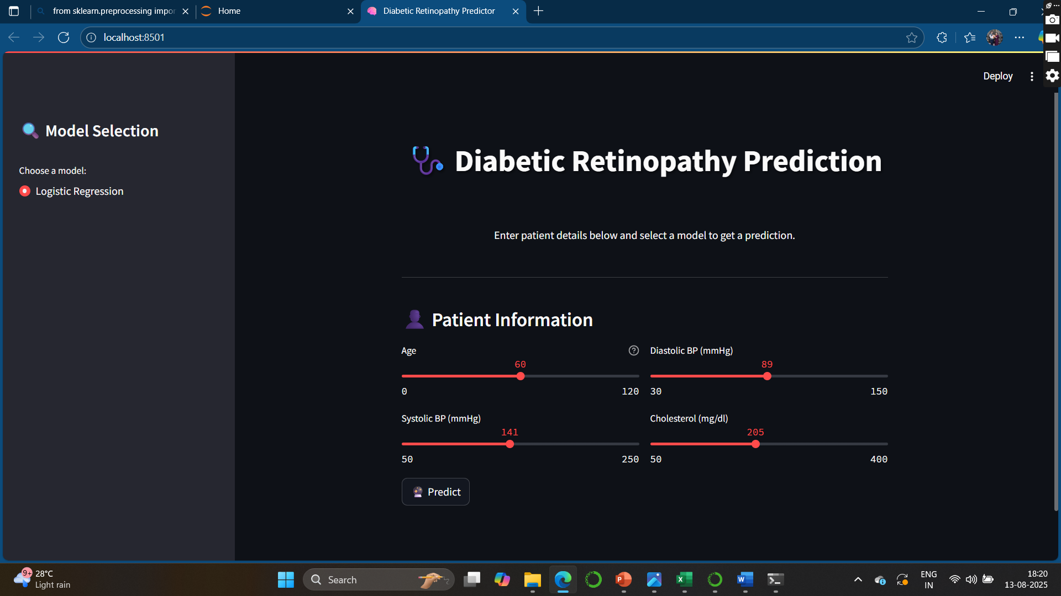

Slide 22
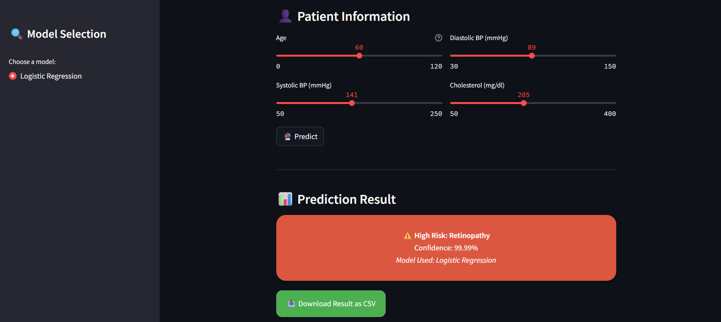
Insights & Findings :
Based on the blood test features, it can be predicted whether a patient will suffer from diabetic retinopathy or not.

Slide 23
Challenges Faced:
Encoding the variables
Model building
Deployment phase.

Slide 24


